Slide 1
Salary Caps On Professional Athletes
By: Ashley Reece
Persuasive writing
Problem/ solution

Slide 2
What is a salary cap? What is the problem with them?
What is a salary cap?
The cap was first introduces for the 1994 season. In professional sports a salary cap is an agreement or rule that places a limit on the amount on the amount of money that a team can spend on their players salaries. Facts show that today salary caps are controversial critics often argue on the grounds of salary caps.
What is the problem with salary caps?
The problem with this is leagues argue that they must justify some sort of equality between their teams.

Slide 3
Why do you think there should be salary caps?
In my opinion Salary caps should exist they keep the payment levels fair. They are effective because they stop salaries from getting out of control and keeps teams profitable. The salary caps bring more fairness to the teams, it makes them more equal. Statistics show that more people think salary caps are effective then don’t but we still need to persuade the people who believe they are uneffective. Therefore they ought to know why salary caps are good.
In this picture it shows statistics of salary caps it provides examples of how much salary caps rise.

Slide 4
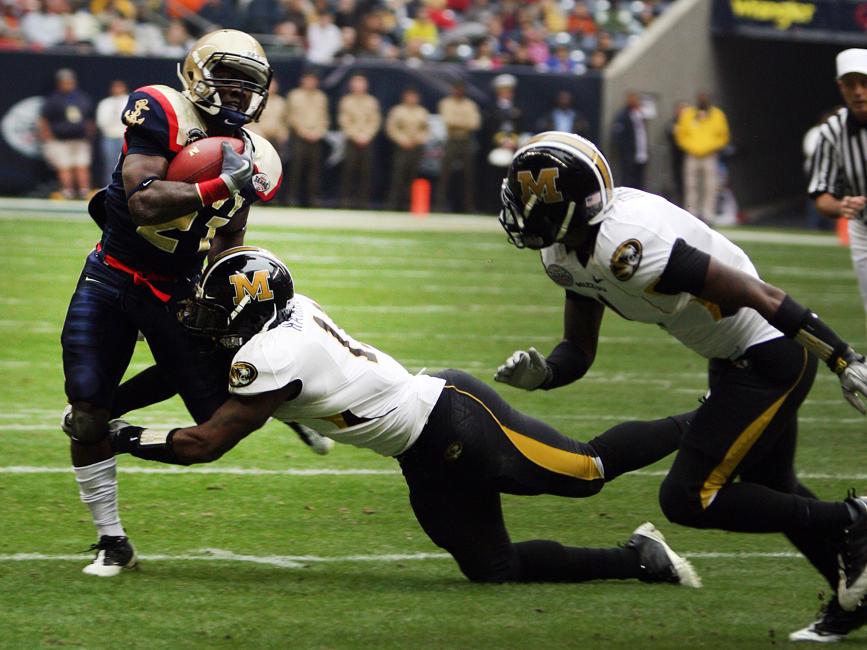
How can we change peoples perspective on salary caps?
What can we do?
We could get the best high school athlete that went to McClure to come and speak to us about facts on salary caps and there opinion on them. They could talk about the comparison of salary caps between teachers and athletes Once they have stated there opinion they could tell us about the august pro’s and con’s of each perspective on if salary caps are bias or not.

Slide 5
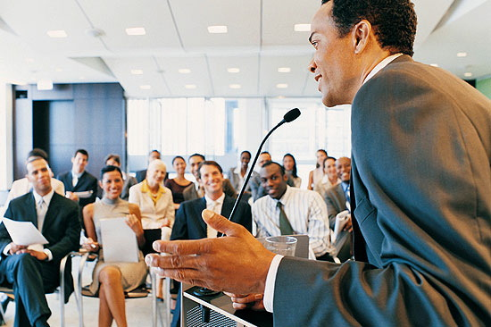
Who would the speaker be directing this to?
The Speaker would direct the information towards Mr. Marcs 5th period class (A.K.A “The Guardians”) or he could talk in the auditorium to all of 8th grade or any others that want to join. The speaker can usurp us to the next level on salary caps
What exactly would the speaker be talking about?
The speaker would be talking about there “expert opinion” on salary caps cite examples on salary caps and talk about ways we can/should fix salary cap issues and get others to divert to the good perspective on salary caps.

Slide 6
Where would the speaker come in?
When would the speaker come in?
The speaker would come in to McClure Middle school and talk to Mr. Marcs 5th period class or the speaker could come into the theater and talk to 8th grade about salary caps but most likely just the class.
The speaker would come in on the month of December or whatever time the speaker can come in but as soon as possible but it would be better if they could come in early December.

Slide 7
Why would the speaker come in?
The speaker would come in because even though problems with salary caps aren’t the main problem right now or the main priority a speaker can still can come to talk to us about pervading the specific evidence no matter what you think about them we can hear two sides of the story. I feel that it is a good idea for the speaker to come in because a lot of children don’t even know the right definition of a salary cap is and I think it is a good that someone wise teaches them and they will be grateful to know the right meaning instead of some wrong answer.
http://www.debate.org/opinions/are-salary-caps-in-professional-sports-effective

